Slide 1
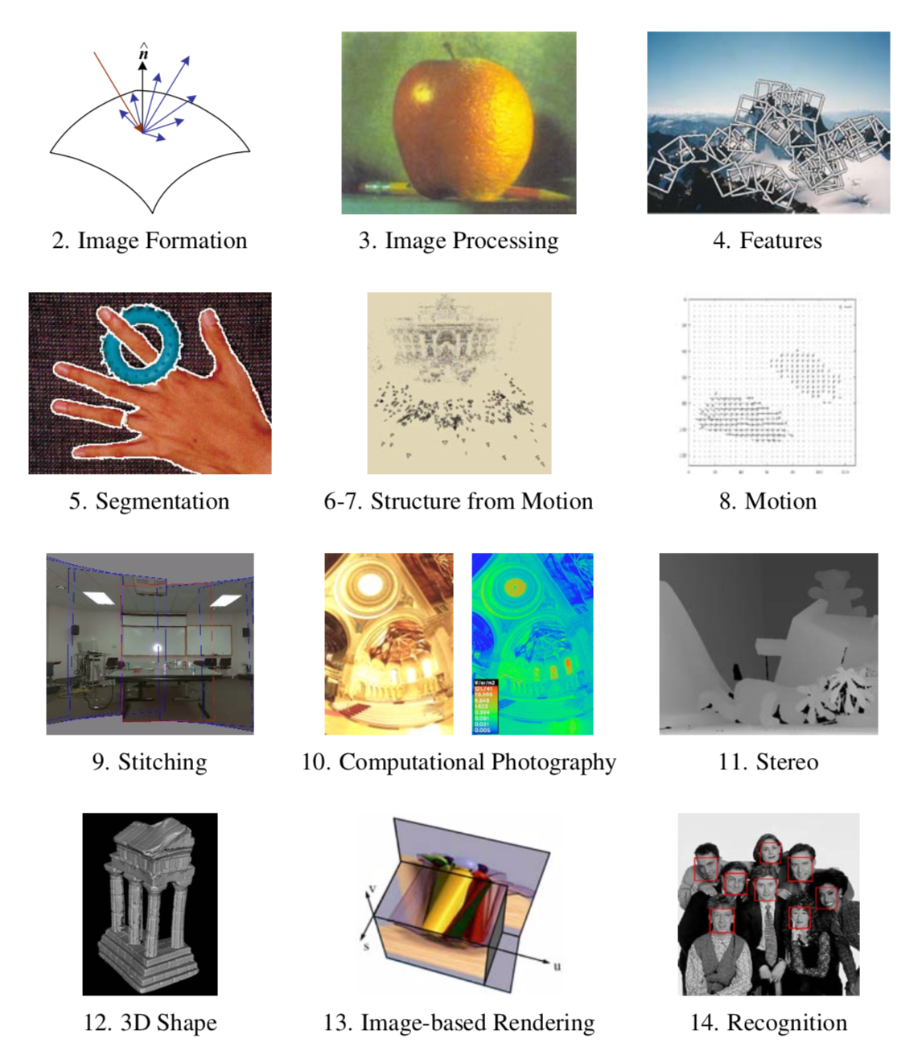

Slide 2
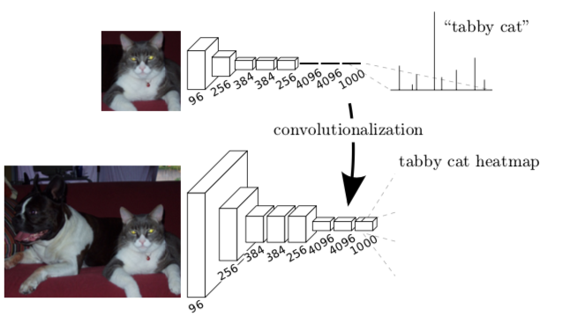
Fully convolutional nets…
”Expand” trained network to any size
Long, J., Shelhamer, E., & Darrell, T. (2015). Fully convolutional networks for semantic segmentation. In CVPR 2014

Slide 3
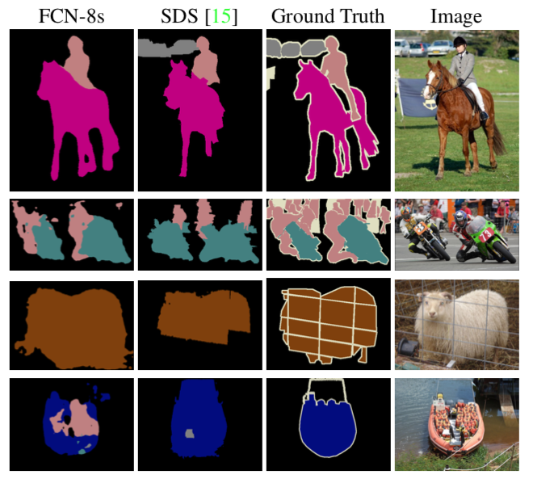
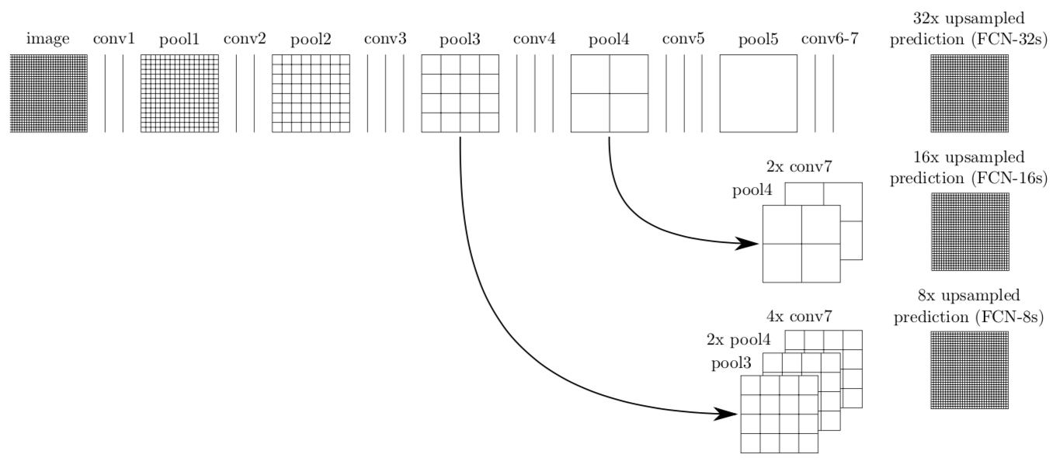
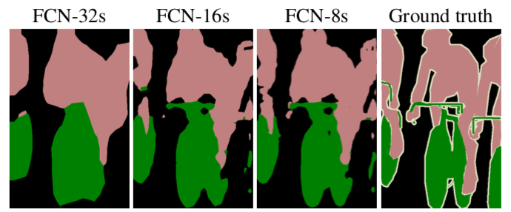
…for segmentation
Complicated upsampling strategies…
Results not yet great
Long, J., Shelhamer, E., & Darrell, T. (2015). Fully convolutional networks for semantic segmentation. In CVPR 2014

Slide 4
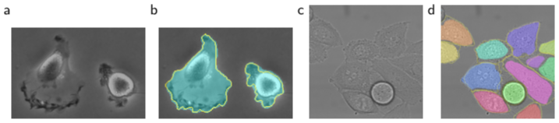
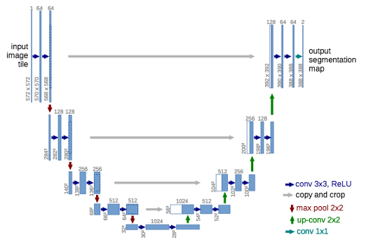
U-Net
Builds on FCN, Contract-expand with skip…
Almost symmetric, many channels at bottom!
O. Ronneberger, P. Fischer, and T. Brox, “U-net: Convolutional networks for biomedical image segmentation,” in MICCAI, pp. 234–241, Springer, 2015.

Slide 5
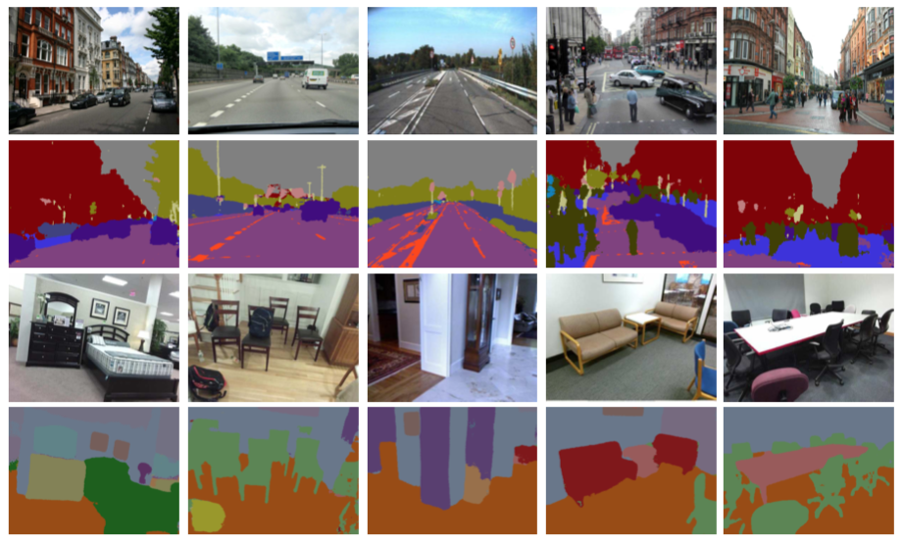
Segnet
Adds…
Segnet: A deep convolutional encoder-decoder architecture for image segmentation
V Badrinarayanan, A Kendall, R Cipolla - PAMI 2017

Slide 6
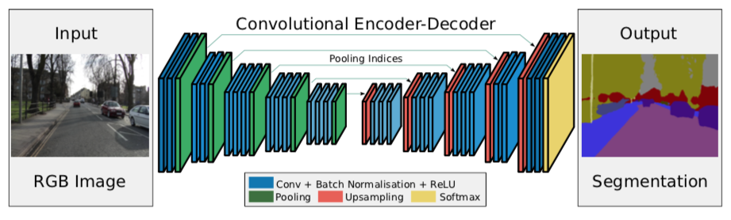
Segnet
Eliminates need to learn the upsamplng
Segnet: A deep convolutional encoder-decoder architecture for image segmentation
V Badrinarayanan, A Kendall, R Cipolla - PAMI 2017

Slide 7
Mask-RCNN…
Neural networks to learn both local feature affinities and top-down context
He et al., “Mask R-CNN,” ICCV 2017 (Best paper)

Slide 8
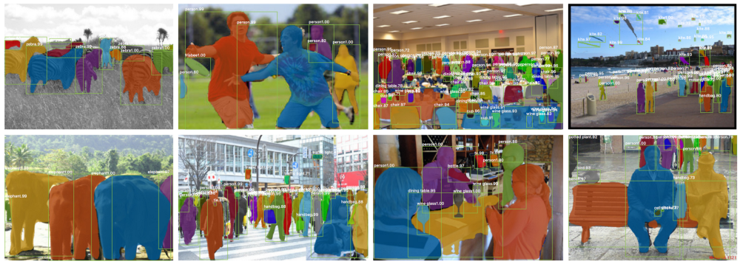
Mask-RCNN…
Results
He et al., “Mask R-CNN,” ICCV 2017 (Best paper)

Slide 9
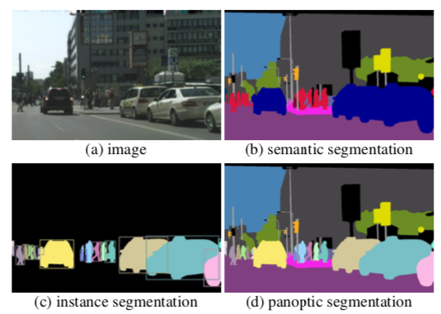
“Panoptic” Segmentation
Segnet = semantic segmentation (every pixel)
Mask-RCNN = instance segmentation (ojects)
Panoptic = combined
Alexander Kirillov, Kaiming He, Ross Girshick, Carsten Rother, and Piotr Dollár. Panoptic segmentation. In CVPR, 2019

Slide 10
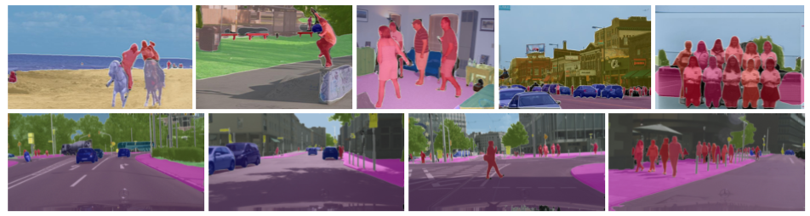
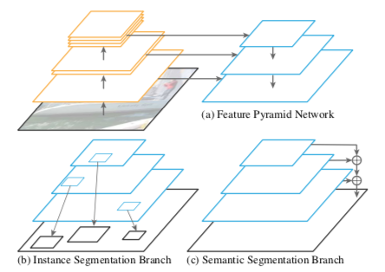
Panoptic Feature Pyramid Networks
Uses FPN architecture
2 heads
Alexander Kirillov, Kaiming He, Ross Girshick, Carsten Rother, and Piotr Dollár. Panoptic Feature Pyramid Networks. In CVPR, 2019

